Slide 1

2024-2025 League Meeting

Slide 2


CVYBO Board Members
Tom Kubicsek
Brian Lewis
Kathy Helfrick
Ryan Hoover
Ben O’Connor
Matt Fontana
Tim Schwartzmiller
Tiffany Doyle
Alex Ameredes
Jamie Calabria
Ryan Milligan

Slide 3
Housekeeping Items:
All emails sent to us must have a Subject Header that states your Team Name, Girls or Boys, Division and Grade.
Also, the coach’s info must be provider if a timely response is expected.
General Emails: cvybabasketball@gmail.com
Scheduling: cvyboschedulechanges@gmail.com
Schedules, Tournaments, Rosters, Contacts, Etc:
https://clubs.bluesombrero.com/cvybo

Slide 4
League Payments:
Team Cost: $275. This must be paid ASAP for your team to be scheduled for games. You can pay via the website or if by check make payable to CVYBO and mailed to 151 Maryland Drive, Carnegie, Pa. 15106
Includes: 10 Regular Season Games, Playoffs & All-Star Game
Referee Fees are not included
If you are not sure if you paid or not, please contact Brian Lewis, 412-818-2143

Slide 5
League Registration:
All teams are registered, and some have provided their rosters and most their coaches via the website.
Please attach your roster and coaches' info through the new website or email us if you haven’t already. We would need this completed prior to start dates.
This will help us with notifying all coaches throughout the season.
All coaches should turn in clearances to their League Directors.

Slide 6
Referee Fees
Regular Season: Each team will have 5 home games and will need to pay the referee fees – 2 refs at $40 per ref ($80 a game). That will need to be a cash payment to the refs at the game.
Playoffs: Each team will need to pay half the referee fees. That will need to be a cash payment to the refs at the game.

Slide 7
Game Facilities
Salvation Army - $3 donation per spectator, cash in the Red Kettle Bell
1060 McNeilly Road
Pittsburgh, Pa. 15226
Drive Basketball Training - $3 gate fee per spectator, cash only
11 Best Drive
Emsworth, Pa. 15202
CCAC Allegheny - $3 gate fee per spectator, cash only
808 Ridge Avenue
Pittsburgh, Pa. 15212
Chartiers Valley School Gyms – No Charge

Slide 8
Game Facilities – Entry/Exit Procedures
Spectators should be respectful of the fans/players that play before you. Let them leave and clear out before trying to sit down unless there are open seats.
After the game is over, please clear the benches so the next team can set up. All post game discussion will have to be done where it won’t interfere with the next game.
Coaches, please have your players clean up their water bottles after the game.

Slide 9
CVYBO League Rules 2023-2024
2nd/3rd & 4th Grade
8 minute quarters with a running clock except for all free throws and the last 2 minutes of the game for all whistles.
Half time is 1 minute long.
1 Full timeout and 2 30 second timeouts per game.
Man to man defense only. No organized press at any time.
Man to man defense begins within the 3-point line. Players within the 3-point line must play man but they are permitted to play help defense( passing lane, one pass, two passes away). However, a defender is permitted to pressure the ball handler once he/she crosses half court.
Help defense that results in a ball handler being double covered by the primary and help defender is not considered an organized trapping defense.
Full court one on one man defense is permitted only in the final 1 minute of regulation and/or the final 1 minute of overtime, unless up by 20 or more points.
No trapping is allowed at any time on any area of the court outside of the 3-point line of the basket the team is defending. The team will receive one warning and then a technical foul will be called. Technical fouls for this offense will not count against the coach toward eviction from the game.
The free throw shooter is allowed to land across the free throw line but can’t be the first to touch the ball on a miss. Players may enter the lane when the shots is released in all grades.
Overtime will be 3 minutes long with a running clock except on foul shots and timeouts. Each team will have one additional 30 second time out. Clock stops the last minute of overtime if the ball goes out of bounds.
2nd overtime can be played if the referees agree that there is enough time left to get the next game in (10 minutes to the hour). Otherwise, the game ends in a tie.
4A/5B Girls Division – When a 4A team is involved, 4th grade rules apply. When the game is between 5B teams, 5th grade rules apply.

Slide 10
CVYBO League Rules 2023-2024
5th Grade
8 minute quarters with a running clock except for all free throws and the last 2 minutes of the game for all whistles.
Half time is 1 minute long.
1 Full timeout and 2 30 second timeouts per game.
No zone defense at any time, man to man defense only.
Organized press for the whole 2nd & 4th quarter unless a team is up by 20 until the lead gets to under 15 points.
Overtime will be 3 minutes long with a running clock except on foul shots and timeouts. Each team will have one additional 30 second time out. Clock stops the last minute of overtime if the ball goes out of bounds.
2nd overtime can be played if the referees agree that there is enough time left to get the next game in (10 minutes to the hour). Otherwise, the game ends in a tie.
6th Grade
9 minute quarters with a running clock except for all free throws and the last 2 minutes of the game for all whistles.
Half time is 1 minute long.
1 Full timeout and 2 30 second timeouts per game.
PIAA High School Rules
Organized press allowed the whole game unless up by 20 until the lead gets to under 15 points.
Overtime will be 3 minutes long with a running clock except on foul shots and timeouts. Each team will have one additional 30 second time out. Clock stops the last minute of overtime if the ball goes out of bounds.
2nd overtime can be played if the referees agree that there is enough time left to get the next game in (10 minutes to the hour). Otherwise, the game ends in a tie.

Slide 11
CVYBO League Rules 2023-2024
7th & 8th Grade
9 minute quarters with a running clock except for all free throws and the last 2 minutes of the game for all whistles.
Half time is 1 minutes long.
1 Full timeouts and 2 30 second timeouts per game.
PIAA High School Rules
Organized press allowed the whole game unless up by 20 until the lead gets to under 15 points.
Overtime will be 3 minutes long with a running clock except on foul shots and timeouts. Each team will have one additional 30 second time out. Clock stops the last minute of overtime if the ball goes out of bounds.
2nd overtime can be played if the referees agree that there is enough time left to get the next game in (10 minutes to the hour). Otherwise, the game ends in a tie.
We are following the lead of Middle School and High School with eliminating the 1&1 on the 7th foul. On the 5th team foul each quarter the team that was fouled will be awarded 2 free throws. Team fouls will reset each quarter.

Slide 12
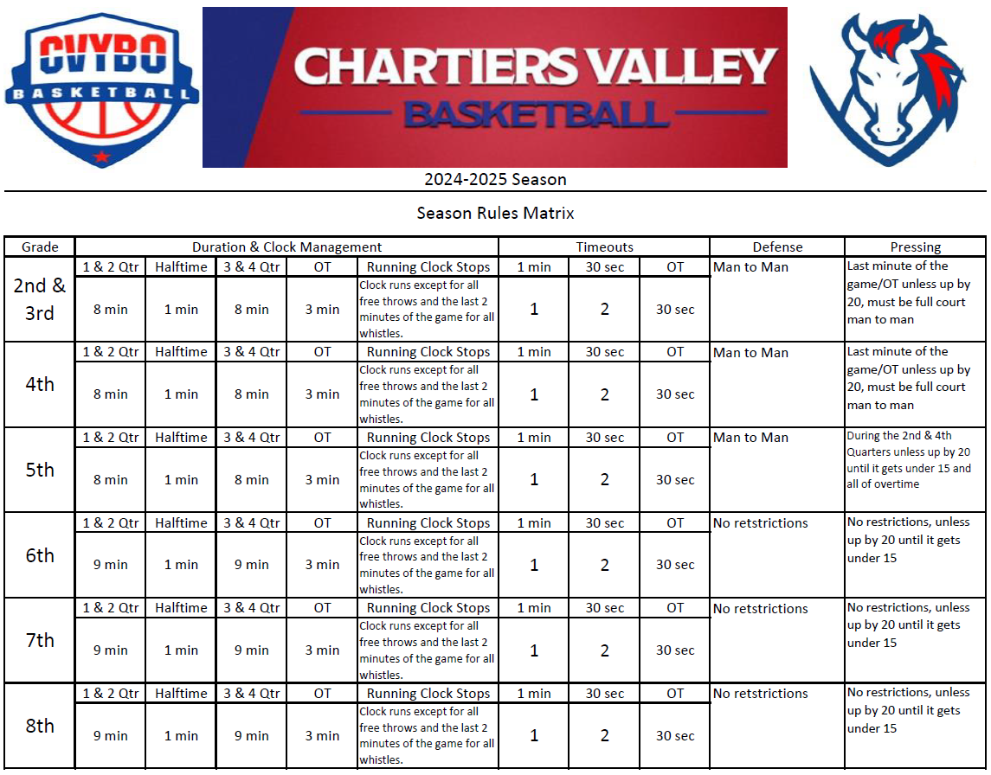

Slide 13
Game Schedule
Games will start December 3rd at Salvation Army and Drive Facility.
Games will start December 7th at CV Gyms
There will be no games scheduled December 23rd through January 1st.
Regular Season’s last day will be no later than February 23rd. Playoffs will start no later than the February 25th with Championship Games completed by March 9th.
Plan is to have the schedule ready for team’s review by Thanksgiving.
Drive is Tues, Thurs & Fri(6-9), Sat(11-9) & Sun(11-7)
Salvation Army is Wed, Thurs & Fri(6-9), Sat(8-9) & Sun(1-9)
CV Gyms are Fri(6-8), Sat & Sun(8:30-3:30)

Slide 14
Posting Game Scores
All score will be posted via a Google Form by the winning team. We ask that this form gets filled out ASAP after each game. We will send out the Google Form along with posting it to our website.
We will upload scores to the website by the end of day each Monday.
Please vote for MVP for the other team after your game and record that with your score reporting. This will determine who is in the All-Star Game at the end of the year along with the Fab 5 for 2nd/3rd & 4th grade.
All teams make the playoffs.

Slide 15
PA State Qualifier
The CVYBO League will be a PA State Qualifier event again this year. The State Qualifying teams will be based on standings on a date picked by the PA State Tournament. The number of teams that qualify is based on how many teams are in each division.
If there are any discrepancies or issues CVYBO Board members have the right to remove teams from eligibility of these playoffs based on code of conduct and other items.
State Qualifier information is posted on our website.

Slide 16
*Coach should ask Parents and Players to sign
Parent Code of Conduct - https://clubs.bluesombrero.com/portals/54949/docs/parents%20code%20of%20conduct.pdf
Player Code of Conduct - https://clubs.bluesombrero.com/portals/54949/docs/players%20code%20of%20conduct.pdf
Coaches Code of Conduct - https://clubs.bluesombrero.com/portals/54949/docs/coaches%20code%20of%20conduct.pdf

